Slide 1
Imitation Learning

Slide 2
Introduction
Imitation Learning
Also known as learning by demonstration, apprenticeship learning
An expert demonstrates how to solve the task
Machine can also interact with the environment, but cannot explicitly obtain reward.
It is hard to define reward in some tasks.
Hand-crafted rewards can lead to uncontrolled behavior
Three approaches:
Behavior Cloning
Inverse Reinforcement Learning
Generative Adversarial Network
Notes:
əˋprɛntɪsʃɪp

Slide 3
Behavior Cloning

Slide 4
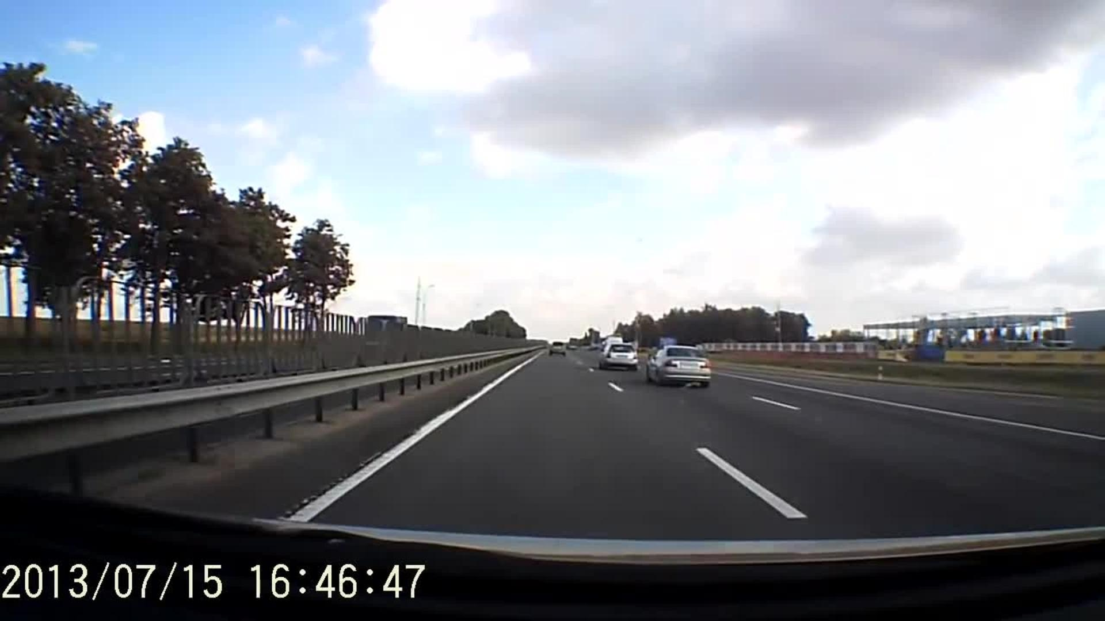
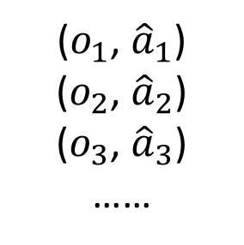
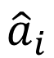
Behavior Cloning
Yes, this is supervised learning.
Self-driving cars as example
Expert (Human driver): 向前
observation
Machine: 向前
Training data:
($o_{1}$, ${\hat{a}}_{1}$)
($o_{2}$, ${\hat{a}}_{2}$)
($o_{3}$, ${\hat{a}}_{3}$)
……
NN
o_{i}
a_{i}
$${\hat{a}}_{i}$$
Actor

Slide 5
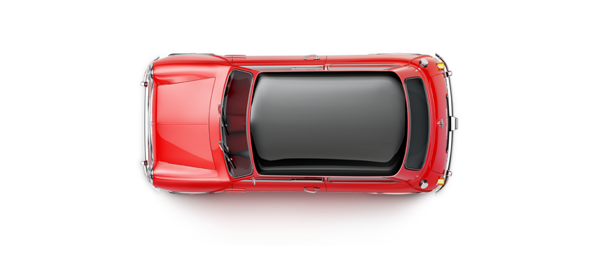
Behavior Cloning
Problem
Expert only samples limited observation (states)
?
Expert
Let the expert in the states seem by machine
Dataset Aggregation

Slide 6


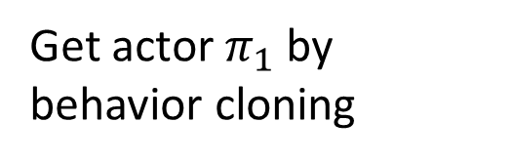
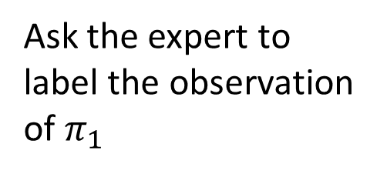
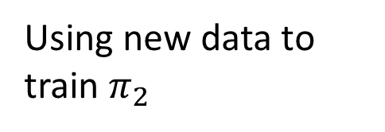
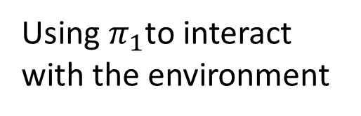
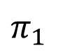
Behavior Cloning
Dataset Aggregation
Get actor $π_{1}$ by behavior cloning
Expert
Using $π_{1}$to interact with the environment
Expert
Ask the expert to label the observation of $π_{1}$
$π_{1}$
Using new data to train $π_{2}$

Slide 7

Behavior Cloning
The agent will copy every behavior, even irrelevant actions.
https://www.youtube.com/watch?v=j2FSB3bseek

Slide 8


Behavior Cloning
Major problem: if machine has limited capacity, it may choose the wrong behavior to copy.
Some behavior must copy, but some can be ignored.
Supervised learning takes all errors equally
speech
speech
NN
NN
o_{i}
a_{i}
o_{i}
a_{i}
gesture
gesture
Actor
Actor
Notes:
http://dariusforoux.com/stop-imitating-habits-successful-people/

Slide 9
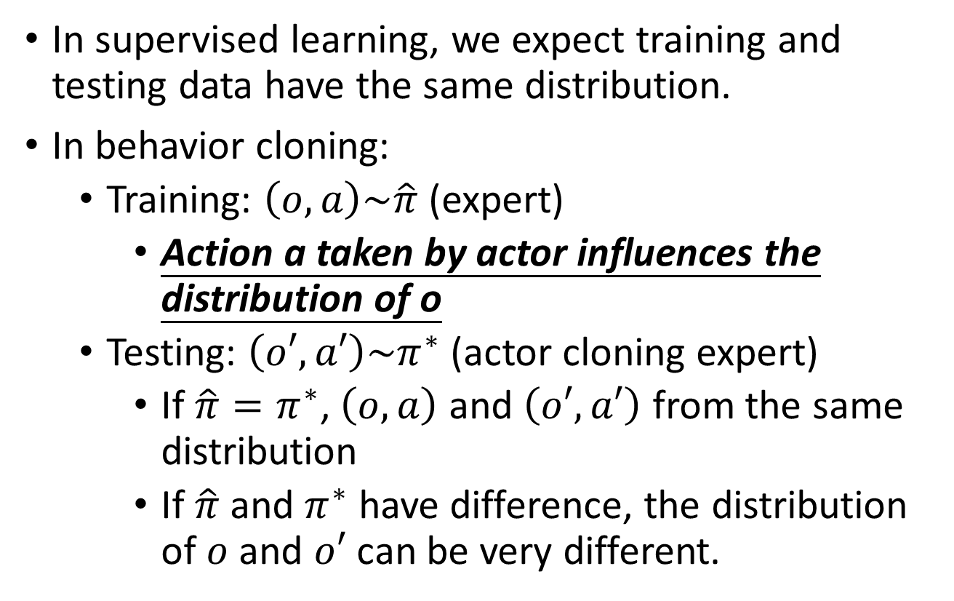
Mismatch
o_{i}
Actor
a_{i}
In supervised learning, we expect training and testing data have the same distribution.
In behavior cloning:
Training: $\left(o,a\right)\sim \hat{π}$ (expert)
Action a taken by actor influences the distribution of o
Testing: $\left(o′,a′\right)\sim π^{∗}$(actor cloning expert)
If $\hat{π}=π^{∗}$, $\left(o,a\right)$ and $\left(o′,a′\right)$ from the same distribution
If $\hat{π}$ and $π^{∗}$ have difference, the distribution of $o$ and $o′$ can be very different.

Slide 10
Inverse Reinforcement Learning (IRL)
Also known as inverse optimal control,
inverse optimal planning
Pieter Abbeel and Andrew Y. Ng. "Apprenticeship learning via inverse reinforcement learning“, ICML, 2004
Notes:
http://www.ipibresume.com/blog/blog/learn-the-core-of-how-to-succeed-in-career/
總結一句話：Correlation doesn't mean causation. 即使你輟學、經常辱罵員工、喜歡穿牛仔褲與套頭衫，你也成為不了Steve Jobs ：）
Apprentiship learning via inverse reinforcement learning will try to infer the goal of the teacher. In other words, it will learn a reward function from observation, which can then be used in reinforcement learning. If it discovers that the goal is to hit a nail with a hammer, it will ignore blinks and scratches from the teacher, as they are irrelevant to the goal.

Slide 11
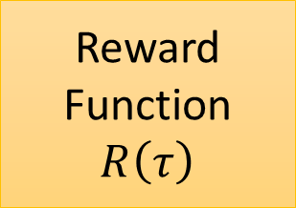
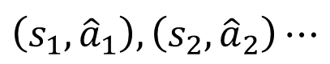

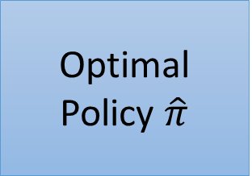
Inverse Reinforcement Learning
Environment Dynamics
P(s’|s,a)
trajectory $\hat{τ}$
$$\left(s_{1}, {\hat{a}}_{1}\right),\left(s_{2},{\hat{a}}_{2}\right)⋯$$
Reward Function
$$R\left(τ\right)$$
Inverse Reinforcement Learning
Optimal Policy $\hat{π}$
Reinforcement Learning
Using the reward function to find a policy $π^{∗}$
Modeling reward can be easier. Simple reward function can lead to complex policy.
Notes:
Inverse RL vs. behavioral cloning
Which has the most succinct description: π* vs. R*?

Slide 12
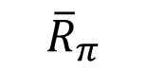
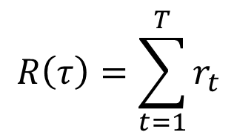
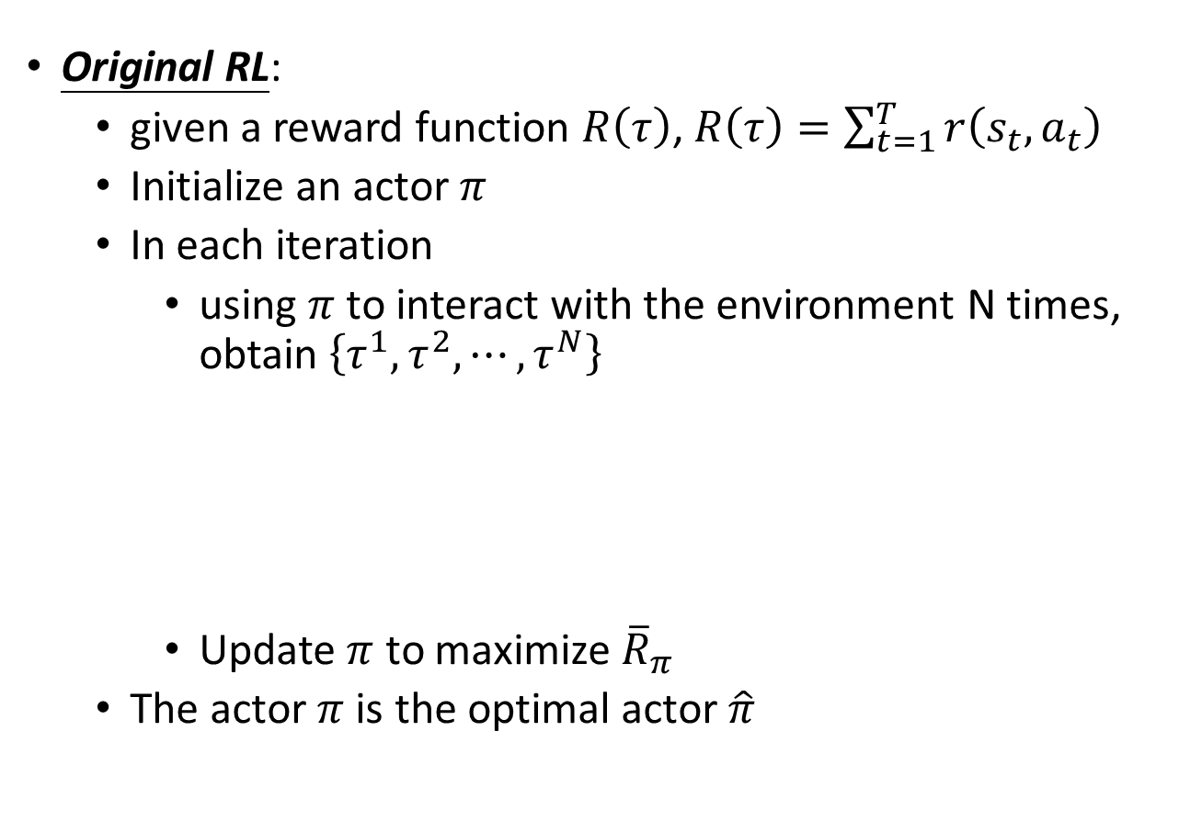
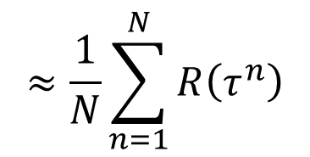
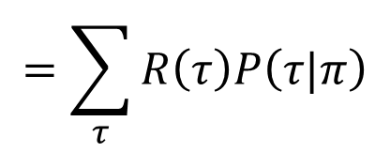
Inverse Reinforcement Learning
Original RL:
given a reward function $R\left(τ\right)$, $R\left(τ\right)=\sum_{t=1}^{T}{r\left(s_{t},a_{t}\right)}$
Initialize an actor $π$
In each iteration
using $π$ to interact with the environment N times, obtain $\left\{τ^{1},τ^{2},⋯,τ^{N}\right\}$
Update $π$ to maximize ${\overline{R}}_{π}$
The actor $π$ is the optimal actor $\hat{π}$
$$τ=\left\{s_{1},a_{1},r_{1},s_{2},a_{2},r_{2},⋯,s_{T},a_{T},r_{T}\right\}$$
$$R\left(τ\right)=\sum_{t=1}^{T}{r_{t}}$$
$$=\sum_{τ}{R\left(τ\right)P\left(τ|π\right)}$$
$$≈\frac{1}{N}\sum_{n=1}^{N}{R\left(τ^{n}\right)}$$
$${\overline{R}}_{π}$$

Slide 13
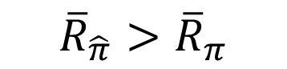
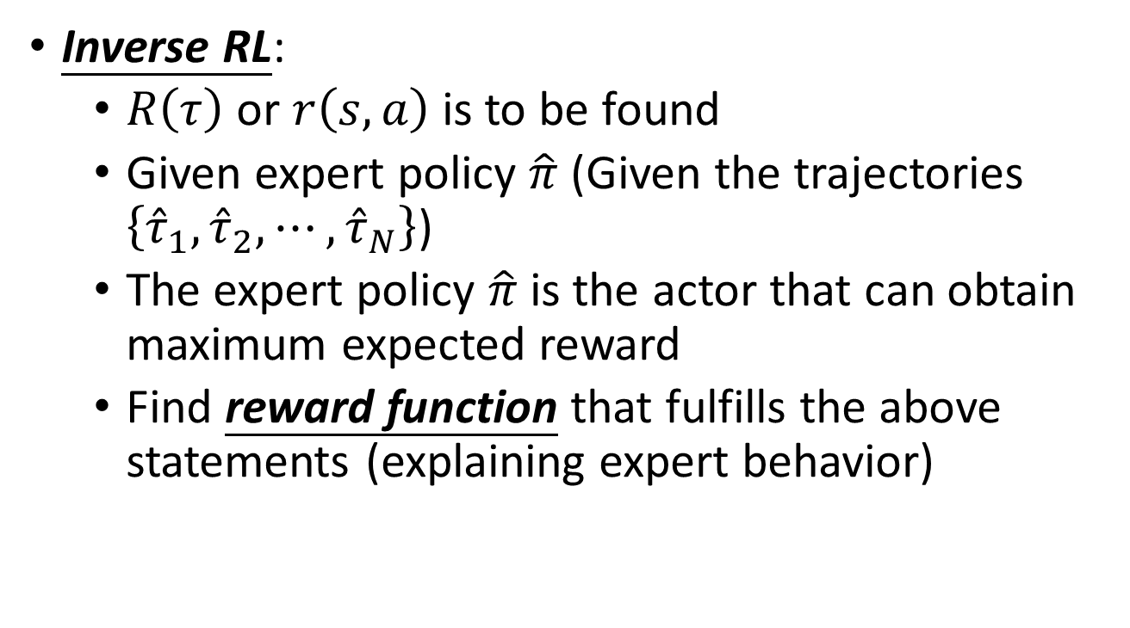
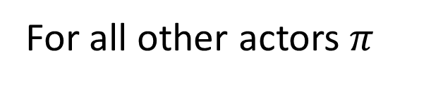
Inverse Reinforcement Learning
Inverse RL:
$R\left(τ\right)$ or $r\left(s,a\right)$ is to be found
Given expert policy $\hat{π}$ (Given the trajectories $\left\{{\hat{τ}}_{1},{\hat{τ}}_{2},⋯,{\hat{τ}}_{N}\right\}$)
The expert policy $\hat{π}$ is the actor that can obtain maximum expected reward
Find reward function that fulfills the above statements (explaining expert behavior)
$${\overline{R}}_{\hat{π}}>{\overline{R}}_{π}$$
For all other actors $π$

Slide 14
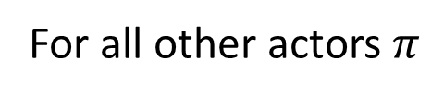
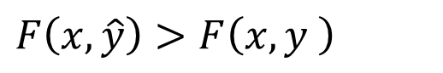
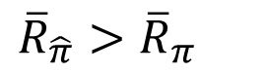
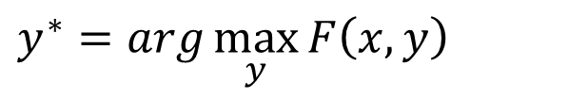
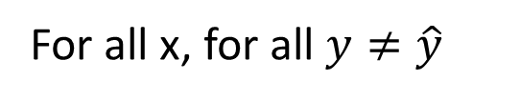
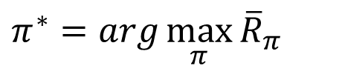
Ring a bell in your mind?
Inverse Reinforcement Learning
Structured Learning
Find reward function:
Training:
$${\overline{R}}_{\hat{π}}>{\overline{R}}_{π}$$
$$F\left(x,\hat{y}\right)>F\left(x,y \right)$$
For all other actors $π$
For all x, for all $y≠\hat{y}$
Find policy:
Testing (Inference):
$$π^{∗}=arg\max_{π}{{\overline{R}}_{π}}$$
$$y^{∗}=arg\max_{y}{F\left(x,y\right)}$$

Slide 15
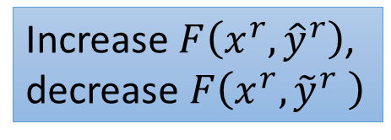
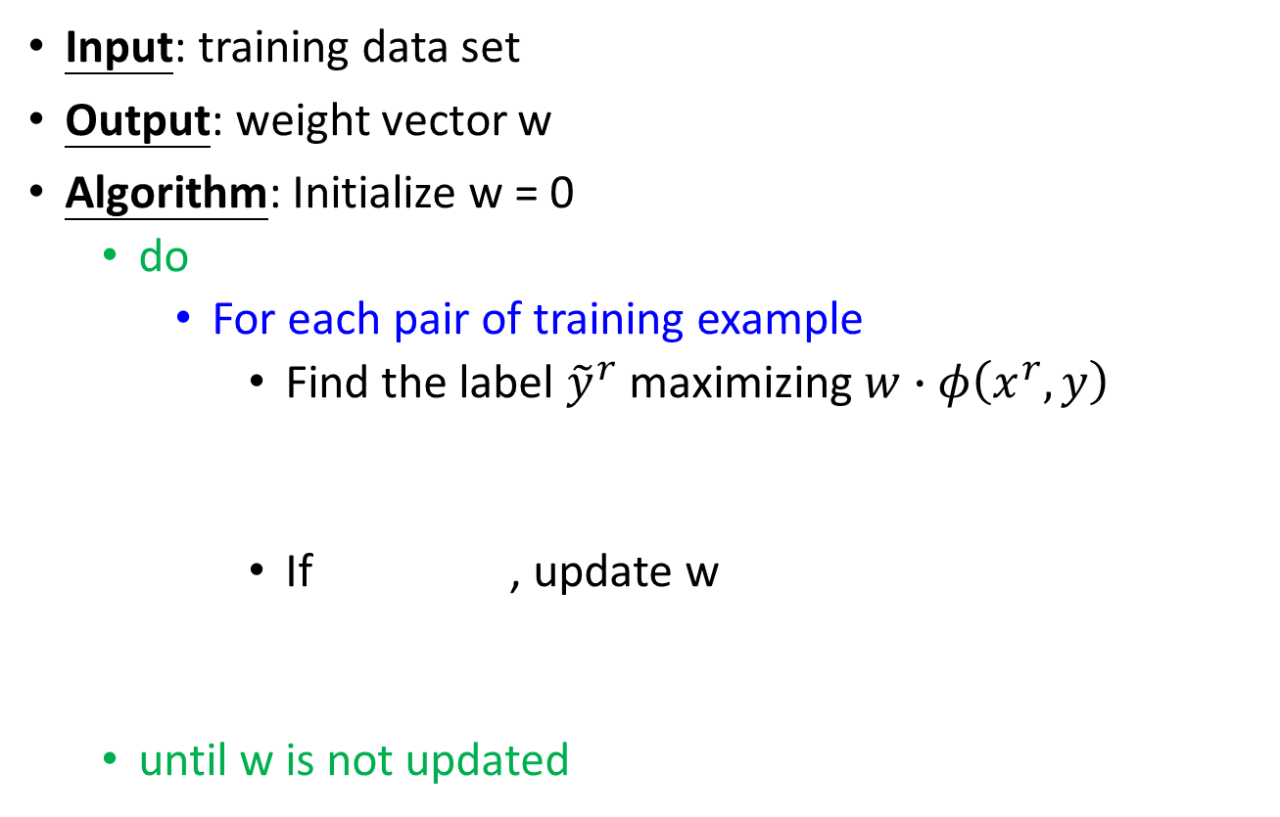
Review: Structured Perceptron
Input: training data set
Output: weight vector w
Algorithm: Initialize w = 0
do
For each pair of training example
Find the label ${\tilde{y}}^{r}$ maximizing $w∙φ\left(x^{r},y\right)$
If , update w
until w is not updated
Can be an issue
Increase $F\left(x^{r},{\hat{y}}^{r}\right)$, decrease $F\left(x^{r},{\tilde{y}}^{r} \right)$
We are done!
Notes:
Question 1 and 2 is solved.
Important: if the weight if not update, end the algorithm

Slide 16
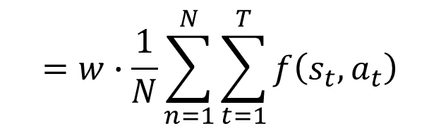
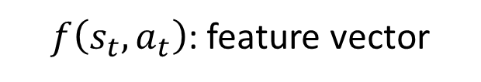
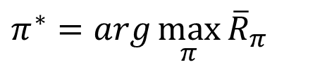
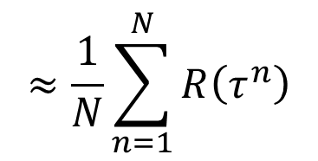
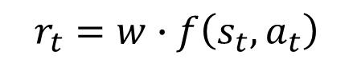
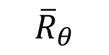
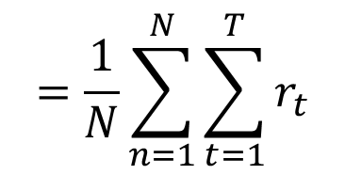
IRL v.s. Structured Perceptron
$$τ=\left\{s_{1},a_{1},r_{1},s_{2},a_{2},r_{2},⋯,s_{T},a_{T},r_{T}\right\}$$
$$≈\frac{1}{N}\sum_{n=1}^{N}{R\left(τ^{n}\right)}$$
$$=\frac{1}{N}\sum_{n=1}^{N}{\sum_{t=1}^{T}{r_{t}}}$$
$$=w∙\frac{1}{N}\sum_{n=1}^{N}{\sum_{t=1}^{T}{f\left(s_{t},a_{t}\right)}}$$
$${\overline{R}}_{θ}$$
$$r_{t}=w∙f\left(s_{t},a_{t}\right)$$
$f\left(s_{t},a_{t}\right)$: feature vector
w: Parameters
$$π^{∗}=arg\max_{π}{{\overline{R}}_{π}}$$
This is reinforcement learning.

Slide 17
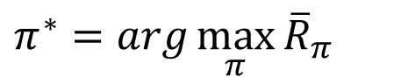
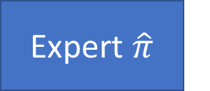
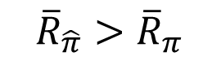
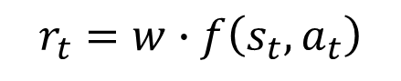
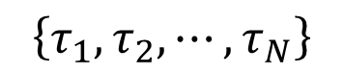
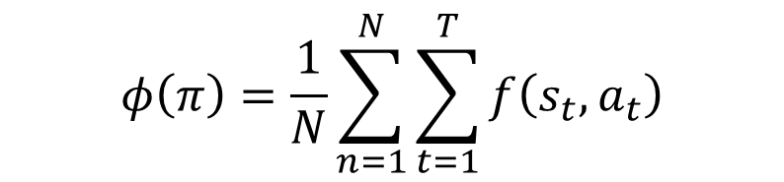
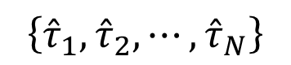
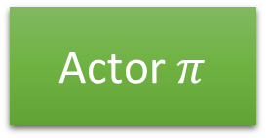
Framework of IRL
$$φ\left(π\right)=\frac{1}{N}\sum_{n=1}^{N}{\sum_{t=1}^{T}{f\left(s_{t},a_{t}\right)}}$$
Expert $\hat{π}$
Update reward function such that:
$$\left\{{\hat{τ}}_{1},{\hat{τ}}_{2},⋯,{\hat{τ}}_{N}\right\}$$
Self driving: record human drivers
$${\overline{R}}_{\hat{π}}>{\overline{R}}_{π}$$
random reward function
Robot: grab the arm of robot
$$\left\{τ_{1},τ_{2},⋯,τ_{N}\right\}$$
Assume
Update actor:
Actor $π$
$$π^{∗}=arg\max_{π}{{\overline{R}}_{π}}$$
$$r_{t}=w∙f\left(s_{t},a_{t}\right)$$
By Reinforcement learning

Slide 18
GAN for Imitation Learning
Jonathan Ho and Stefano Ermon. "Generative adversarial imitation learning“, NIPS, 2016

Slide 19
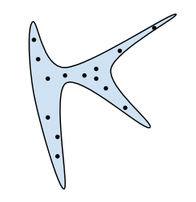

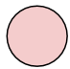

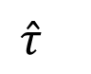

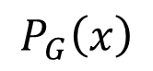
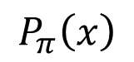
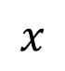




GAN v.s. Imitation Learning
$$P_{G}\left(x\right)$$
$$P_{data}\left(x\right)$$
Normal Distribution
generator
G
$$x$$
$$z$$
As close as possible
Dynamic in environment
$$P_{π}\left(x\right)$$
$$P_{\hat{π}}\left(x\right)$$
actor
$$π$$
$$τ$$
$$z$$
$$\hat{τ}$$
As close as possible

Slide 20






GAN for Imitation Learning
Expert $\hat{π}$
Discriminator D
$$\left\{{\hat{τ}}_{1},{\hat{τ}}_{2},⋯,{\hat{τ}}_{N}\right\}$$
A trajectory export or not
$$\left\{τ_{1},τ_{2},⋯,τ_{N}\right\}$$
Find actor $π$ such that
Find a discriminator such that
$$D\left(τ_{i}\right)$$
Actor $π$
$$D\left({\hat{τ}}_{i}\right)$$
$$D\left(τ_{i}\right)$$

Slide 21












GAN for Imitation Learning
Discriminator
$$D\left({\hat{τ}}_{i}\right)$$
$$D\left(τ_{i}\right)$$
$$τ=\left\{s_{1},a_{1}, s_{2},a_{2}, ⋯,s_{T},a_{T} \right\}$$
$$s$$
Local Discriminator d
$$D\left(τ\right)=\frac{1}{T}\sum_{t=1}^{T}{d\left(s_{t},a_{t}\right)}$$
$$d\left(s,a\right)$$
$$a$$
(s,a) from expert
$$d\left(s,a\right)$$
$$D\left({\hat{τ}}_{i}\right)$$
$$D\left(τ_{i}\right)$$
(s,a) from actor
$$d\left(s,a\right)$$
Notes:
Reward?

Slide 22







GAN for Imitation Learning
Generator
$$τ=\left\{s_{1},a_{1}, s_{2},a_{2}, ⋯,s_{T},a_{T} \right\}$$
Find actor $π$ such that
$$D\left(τ\right)=\frac{1}{T}\sum_{t=1}^{T}{d\left(s_{t},a_{t}\right)}$$
$$D\left(τ_{i}\right)$$
$$θ^{π}←θ^{π}+η\sum_{i=1}^{N}{D\left(τ_{i}\right)}∇_{θ^{π}}logP\left(τ_{i}|π\right)$$
$$θ^{π}←θ^{π}+η∇_{θ^{π}}E_{π}\left[D\left(τ\right)\right]$$
policy gradient
Each step in the same trajectory can have different values.
Given discriminator D
Using $π$ to interact with the environment to obtain$\left\{τ_{1},τ_{2},⋯,τ_{N}\right\}$
If D($τ_{i}$) is large, increase $P\left(τ_{i}|π\right)$; otherwise, decrease $P\left(τ_{i}|π\right)$

Slide 23



Algorithm
Input: expert trajectories $\left\{{\hat{τ}}_{1},{\hat{τ}}_{2},⋯,{\hat{τ}}_{N}\right\}$
Initialize discriminator D and actor $π$
In each iteration:
Using actor to obtain trajectories $\left\{τ_{1},τ_{2},⋯,τ_{N}\right\}$
Update discriminator parameters: Increase $D\left({\hat{τ}}_{i}\right)$, decrease $D\left(τ_{i}\right)$
Update actor parameters: Increase $D\left(τ_{i}\right)$
$$D\left(τ\right)=\frac{1}{T}\sum_{t=1}^{T}{d\left(s_{t},a_{t}\right)}$$
reward
Find the reward function that expert has larger reward.
$$θ^{π}←θ^{π}+η\sum_{i=1}^{N}{D\left(τ_{i}\right)}∇_{θ^{π}}logP\left(τ_{i}|π\right)$$
Find the actor maximizing reward by reinforcement learning
Notes:
Model-based GAN
https://arxiv.org/pdf/1612.02179.pdf

Slide 24






Recap: Sentence Generation & Chat-bot
Chat-bot
Sentence Generation
Expert trajectory:
input: how are you
Output: I am fine
Expert trajectory:
床 前 明 月 光
(“<BOS>”,”床”)
(“input, <BOS>”,”I”)
$$\left(o_{1},a_{1}\right):$$
$$\left(o_{1},a_{1}\right):$$
(“床”,”前”)
(“input, I”, ”am”)
$$\left(o_{2},a_{2}\right):$$
$$\left(o_{2},a_{2}\right):$$
(“床前”,”明”)
(“input, I am”, ”fine”)
$$\left(o_{3},a_{3}\right):$$
$$\left(o_{3},a_{3}\right):$$
……
……
……
……
Maximum likelihood is behavior cloning. Now we have better approach like SeqGAN.

Slide 25
Examples of Recent Study

Slide 26

Robot
Chelsea Finn, Sergey Levine, Pieter Abbeel, ” Guided Cost Learning: Deep Inverse Optimal Control via Policy Optimization”, ICML, 2016
http://rll.berkeley.edu/gcl/
Notes:
The reward function is not linear.

Slide 27

Parking Lot Navigation
Reward function:
Forward vs. reverse driving
Amount of switching between forward and reverse
Lane keeping
On-road vs. off-road
Curvature of paths

Slide 29
Path Planning

Slide 30



Third Person Imitation Learning
Ref: Bradly C. Stadie, Pieter Abbeel, Ilya Sutskever, “Third-Person Imitation Learning”, arXiv preprint, 2017
First Person
Third Person
http://lasa.epfl.ch/research_new/ML/index.php
https://kknews.cc/sports/q5kbb8.html
http://sc.chinaz.com/Files/pic/icons/1913/%E6%9C%BA%E5%99%A8%E4%BA%BA%E5%9B%BE%E6%A0%87%E4%B8%8B%E8%BD%BD34.png

Slide 31
Third Person Imitation Learning

Slide 32
Third Person Imitation Learning

Slide 33



Slide 34

One-shot Imitation Learning
How to teach robots?
https://www.youtube.com/watch?v=DEGbtjTOIB0

Slide 35

One-shot Imitation Learning

Slide 36

Unstructured Demonstration
Karol Hausman, Yevgen Chebotar, Stefan Schaal, Gaurav Sukhatme, Joseph Lim, Multi-Modal Imitation Learning from Unstructured Demonstrations using Generative Adversarial Nets, arXiv preprint, 2017
Review: InfoGAN
z
z’
Generator
x
Discriminator
=
scalar
c
Predictor
Predict the code c that generates x
c
Notes:
Karol Hausman, Yevgen Chebotar, Stefan Schaal, Gaurav Sukhatme, Joseph LimKarol Hausman, Yevgen Chebotar, Stefan Schaal, Gaurav Sukhatme, Joseph Lim

Slide 37

Unstructured Demonstration
The solution is similar to info GAN
Actor
action
a
Discriminator
observation o
scalar
action code c
Predictor
Expert demonstration:
Predict the code c given o and a
c

Slide 38

Unstructured Demonstration
https://www.youtube.com/watch?v=tpEgL1AASYk
Notes:
https://arxiv.org/pdf/1705.10479.pdf

Slide 39

http://www.commitstrip.com/en/2017/06/07/ai-inside/?

